Slide 1
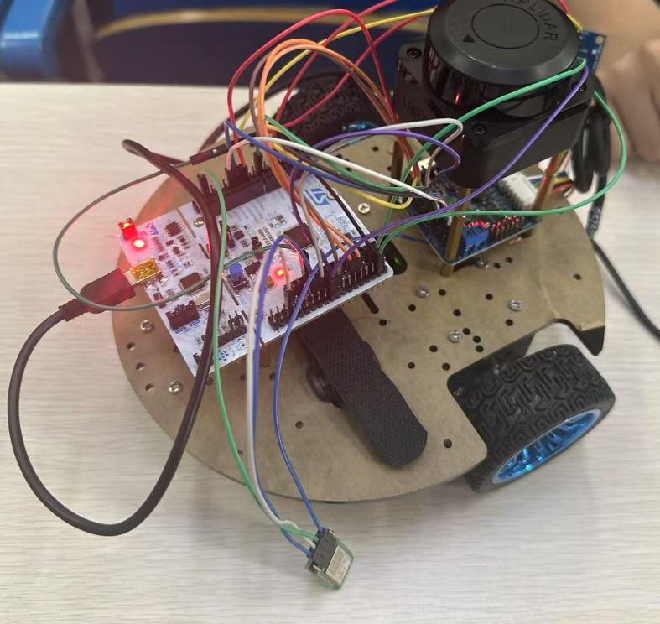
Design & Build Project Demonstration
Group 5

Slide 2
Contents
1. Project Introduction
2. Key Features: Hardware
3. Key Features: Software

Slide 3
1. Project Introduction
Objective:
Design and construct an autonomous mobile robot equipped with a 2D LiDAR system, with the core goal of achieving intelligent maze navigation and real-time environment mapping (3m*3m).
Functions:
The hardware team focuses on the actual sensor integration, obtaining data from 2D lidar and using motor encoders and IMU to calculate the odometer. These data are transmitted to the host for advanced processing. In turn, the hardware must be able to receive navigation commands (such as waypoints/tracks) from the host and execute these commands through real-time motor control using the PID algorithm.
The software team is responsible for high-level data processing and autonomous navigation.They implement the SLAM algorithm to build and update a real-time occupancy grid map based on LiDAR scans and odometry input.They design the left-hand wall-following exploration logic to ensure complete coverage of the unknown maze.Once the exploration is complete, the team uses the A* path planning algorithm to compute the shortest return path and transmits it to the hardware system for execution.The software team also develops the GUI to visualize the robot’s trajectory, sensor readings, and the built map.
Design & Build: Autonomous Mobile Robot for Maze Mapping and Navigation with 2D LiDAR

Slide 4

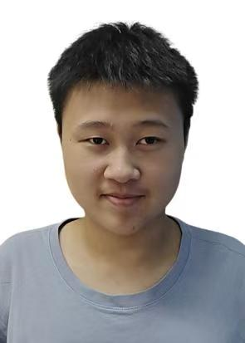




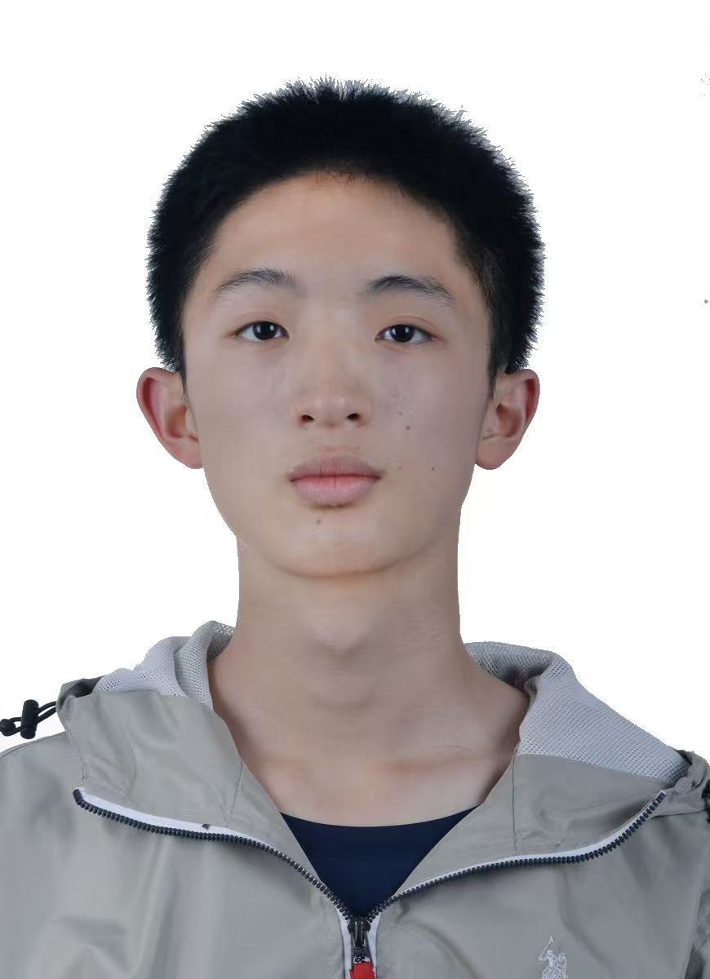




Group Members and Roles
何威翰（EIE）
Encoder Motor
吴亦凡（TEL）
Bluetooth Module
李佳璇（TEL）
Radar
梁锋宁（TEL）
Motor Driver
苏兆麟（EIE）
IMU
张天韵（TEL）
Radar
黄枷赧（TEL）
Motor Driver
潘凯翔（IST）
SLAM Mapping
崔洪清（IoT）
A* Path Planning
孙仟（IoT）
Control Logic
杨易臻（IST）
Data Handling

Slide 5
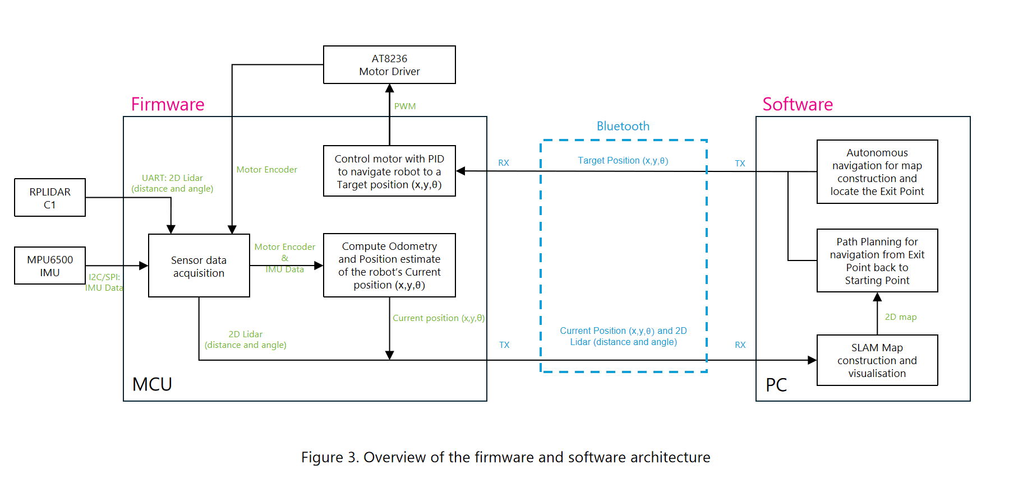
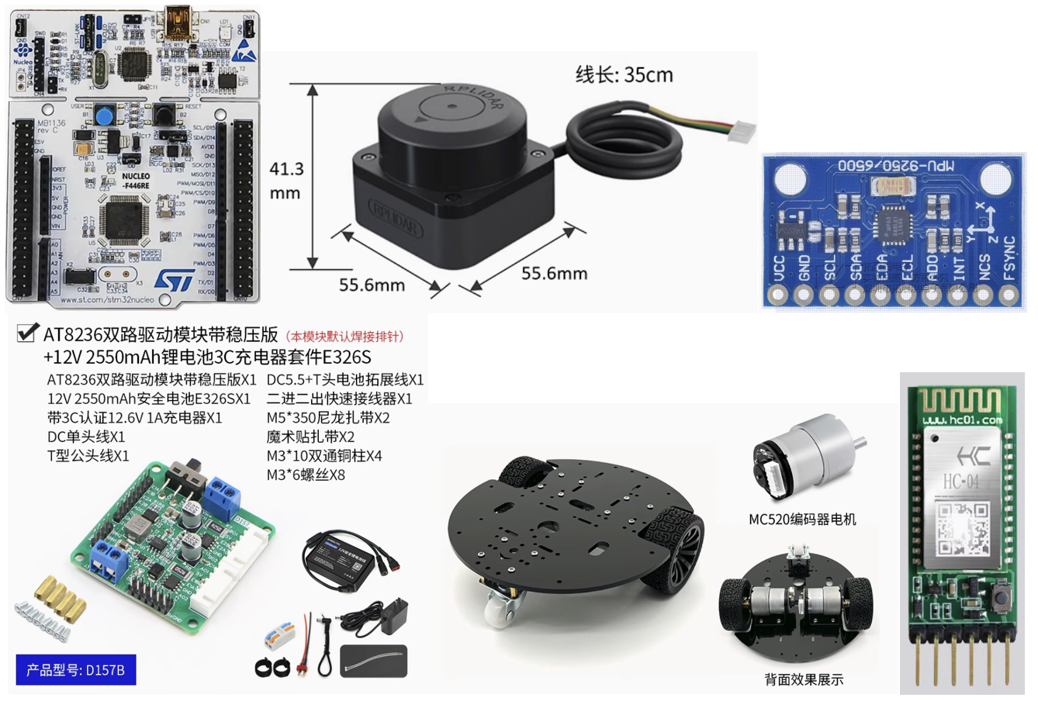
2. Key Features: Hardware
Firmware
Constructions
Completed by Telecom and EIE Team
Figure 2. Hardware Components

Slide 6
2. Key Features: Hardware
Sensor Data Acquisition
RPLIDAR C1
520 gear encoder DC motor
Distance Measurement and Position Estimation
MPU6500 IMU
Motor Control
AT8236 Motor Driver
Use PID control to achieve real-time motor control of speed/position
Bluetooth Communication
Transmit data packets to the host via Bluetooth, including 2D laser radar scan data (angles and distances) and odometry data (x, y, θ)
Notes:
Sensor Data Acquisition
RPLIDAR C1: Collect continuous 360-degree environmental sensing data (including angles and distances), and send the original data to the host.
MPU6500 IMU: Read the direction data, including the readings from the accelerometer and gyroscope.
520 gear encoder DC motor: Provide mobile capabilities with encoder feedback, for speed control and odometer measurement
Distance Measurement and Position Estimation
MPU6500 IMU: Using the collected data to calculate the odometer data, that is, the robot's position (x, y, θ)
Motor Control
AT8236 Motor Driver: Control the 520 tooth encoder DC motor to achieve precise speed and direction control
Use PID control to achieve real-time motor control of speed/position
Bluetooth Communication
Transmit data packets to the host via Bluetooth, including 2D laser radar scan data (angles and distances) and odometry data (x, y, θ)

Slide 7
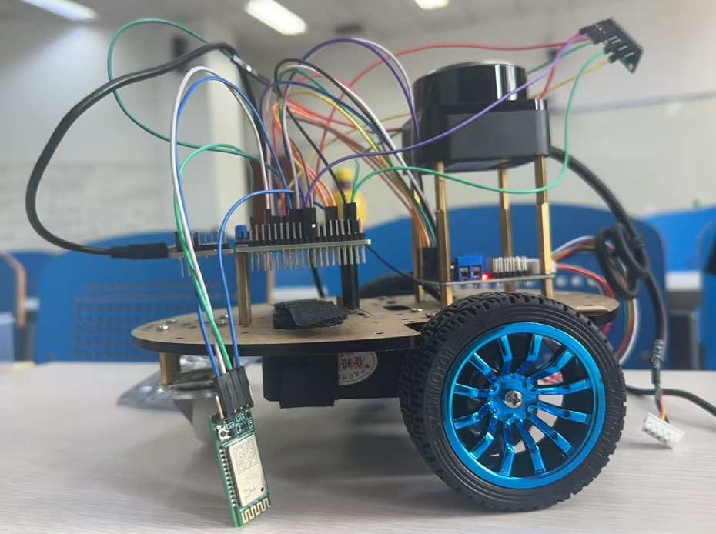
2. Key Features: Hardware
Radar
Motor Driver
STM32F446RE
Bluetooth
Battery
DC Motor

Slide 8
2. Key Features: Hardware（Some Problems and Solutions）
1. STM32F446RE Pin Resource Conflict
Problem: Lidar (UART), Bluetooth module (UART), MPU6500 (SPI) and motor encoder (GPIO) are occupying STM32 pins at the same time, resulting in insufficient resource allocation.
Solution: Solve the problem in advance and plan the pin resources well, stipulate the I/O resources used by radar, bluetooth, IMU, motor and other resources to avoid communication conflicts.In addition, we try to build the code as modular as possible, introduce interrupts in Init and define the interrupt handler function, which realises the serial scheduling of CPU.
2. Lidar data packet loss
Problem: When the RPLIDAR C1 transmits data at a baud rate of 460800bps, the STM32 receive buffer overflows, resulting in missing point cloud data.Solution:
(1) Use DMA to receive data to avoid CPU interrupt blocking.
(2) Software level: Implement ring buffer (size ≥512 bytes) and set up data timeout retransmission mechanism (request retransmission if 3 consecutive frames are missing).
(3) Intercept the radar point cloud data appropriately, intercept the key angle and good quality data points to increase the data transmission efficiency.

Slide 9
2. Key Features: Hardware
Control section:
a. PID Algorithm: It achieves a double-loop closed-loop control of the intelligent trolley. The encoder information and IMU information can be used to achieve automatic deviation correction and precise speed control.
b. Slow start: A linear PID control allows for a small initial acceleration followed by a gradual increase. This effectively alleviates the "nodding" phenomenon of starting.

Slide 10
2. Key Features: Hardware
Perception section:
a. LIDAR: Successful connection and activation of the LIDAR, data can be transmitted back via Bluetooth. Bi-directional communication between the radar and the microcontroller was achieved.
b. IMU: Successful connection and calculation of the Euler angle outgoing. Enhancement of the Kalman filter on top of the existing filter, resulting in more efficient filtering and smoother changes in the gyroscope
Interaction section:
a. Data acquisition and fusion technology: IMU data processing uses complementary filtering algorithms to obtain stable and responsive attitude estimation.
b. Data communication flow optimisation: several optimisation techniques are used in the actual implementation: use of DMA to reduce the burden on the CPU; use of circular buffers to handle continuous data flow; data processing mechanism triggered by interrupts; data forwarding control based on status flags.

Slide 11
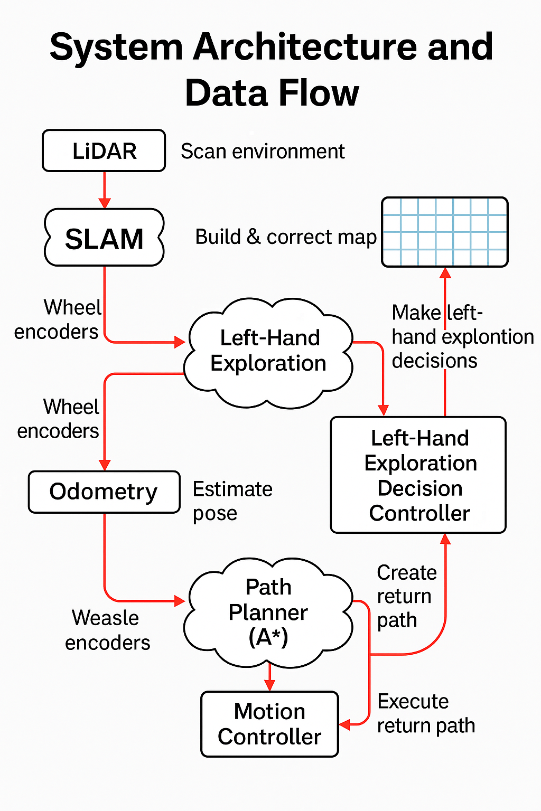
3. Key Features: Software System Architecture and Data Flow
1.LiDAR scans the environment and sends distance data to the SLAM module.
2.The SLAM module builds and updates a global map in real-time.
3.The Left-Hand Exploration module decides movement based on map updates.
4.Odometry estimates the robot’s pose using encoder data.
5.When exploration ends, the A* path planner calculates the shortest return path.The motion controller executes the return path accurately.
Figure5: System Architecture and Data Flow

Slide 12
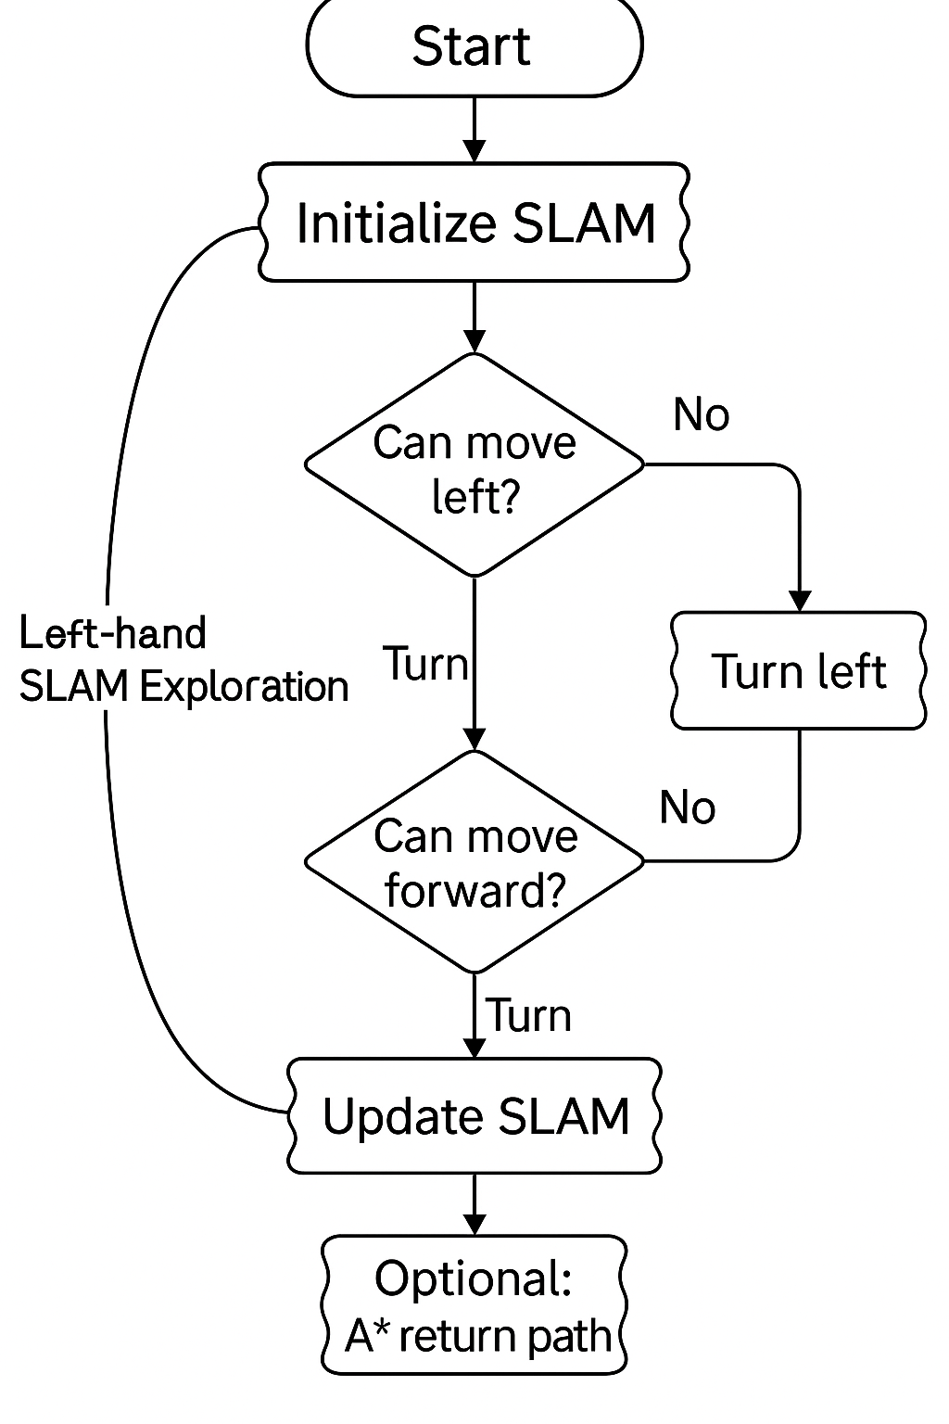
3. Key Features: Software Left-Hand SLAM Exploration Process
The robot initializes the SLAM system using real-time LiDAR input.
Applies the left-hand rule to explore unknown environments.
At each decision point:
If the left side is free ➜ Turn left
Else if forward is free ➜ Move forward
Else ➜ Turn right or turn around
Firure6: Left-Hand SLAM Exploration Process
Continue this process until exploration is complete (all reachable areas visited)
After each movement, update the SLAM map based on the current LiDAR scan and odometry.
Apply A* algorithm to plan the shortest return path to the start point.

Slide 13
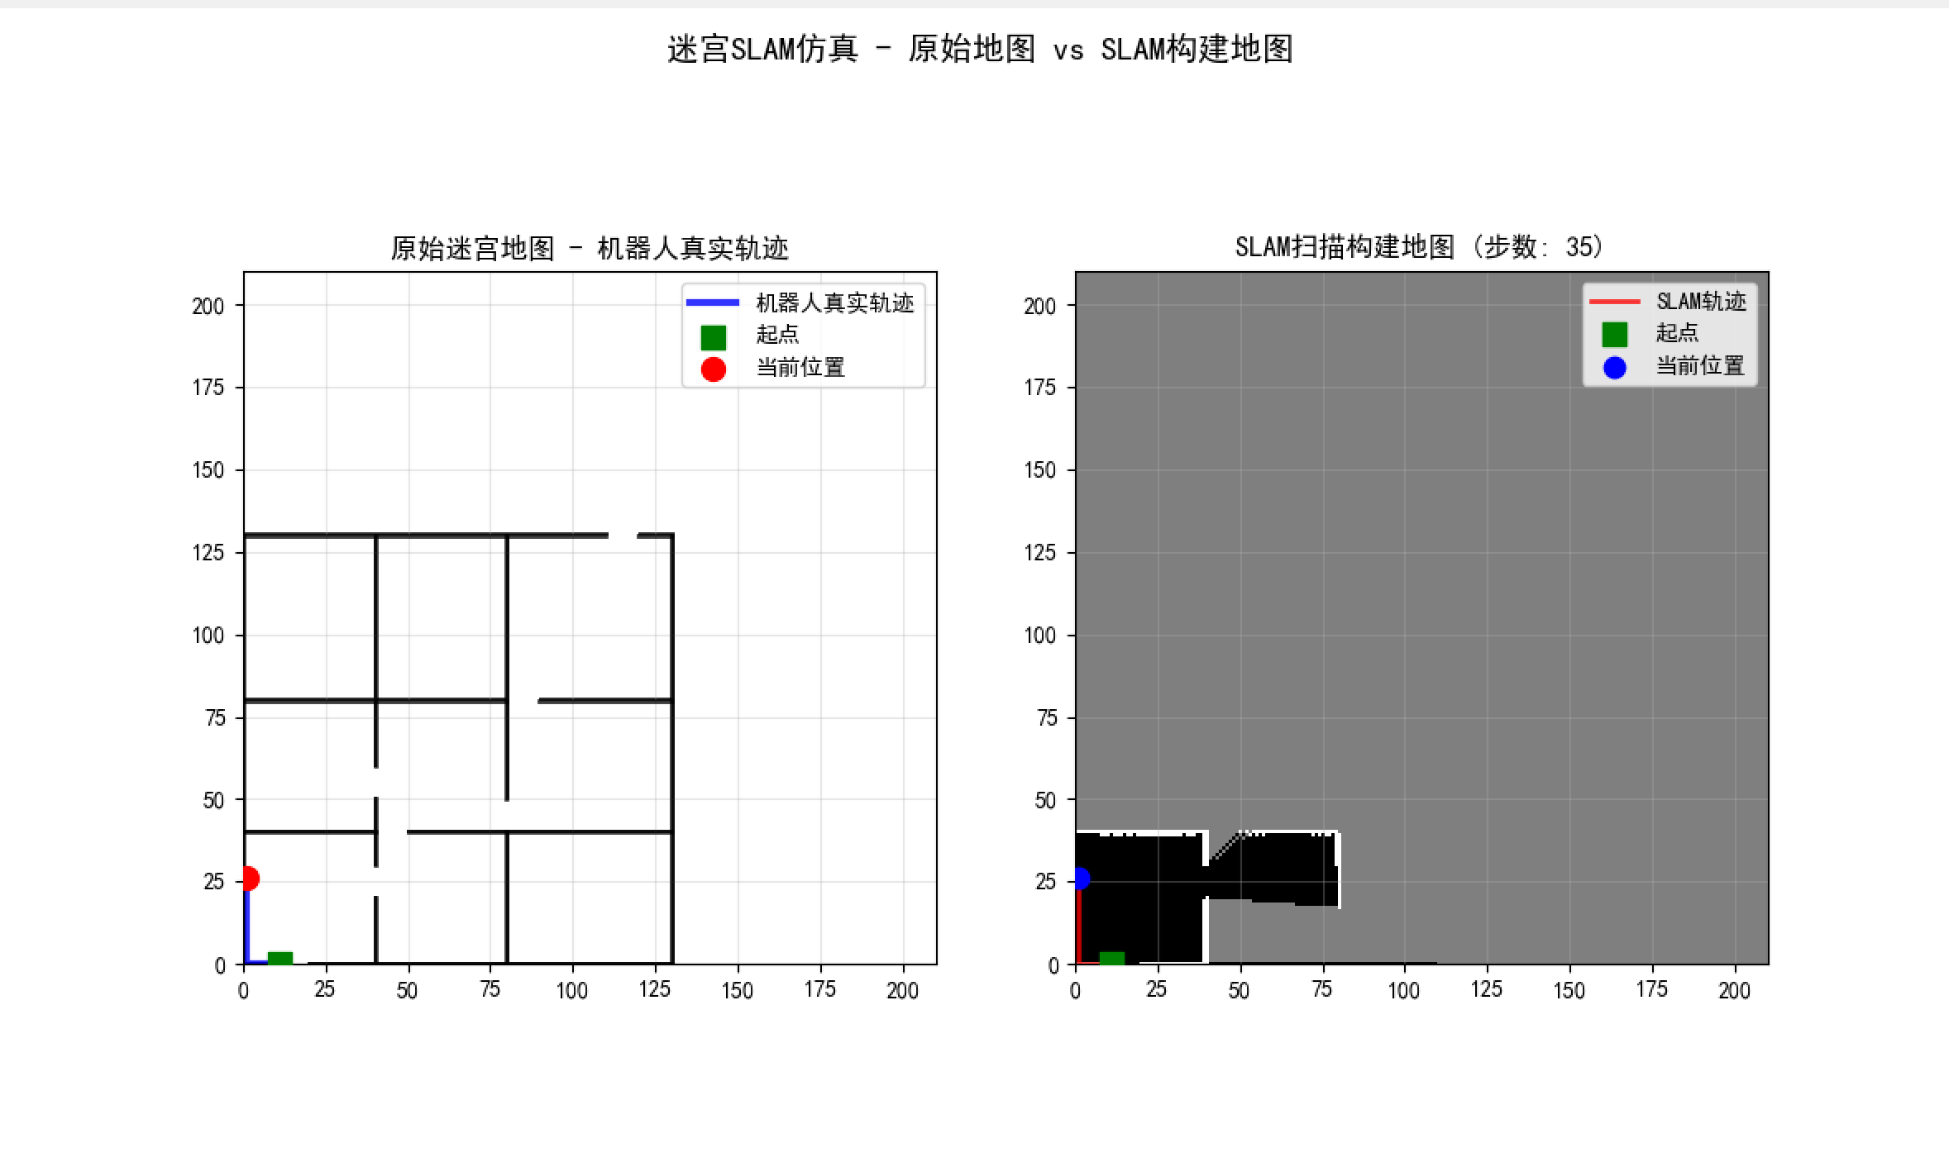
3. Key Features: Software SLAM Mapping with Real LiDAR Data
🎯 The system uses real LiDAR and encoder data from the deployed robot.
📡 LiDAR continuously scans the environment during movement and sends raw distances to the SLAM module.
🗺️ The resulting map is used in real time by the robot to assist exploration and navigation.
✅ Compatible with path planning and return navigation modules.
🔁 Odometry (dx, dy) is estimated from wheel encoders and used to update robot pose.
🧠 RMHC-SLAM algorithm fuses LiDAR and odometry to generate and refine the grid map.
Figure7: Real-World SLAM Mapping Result

Slide 14
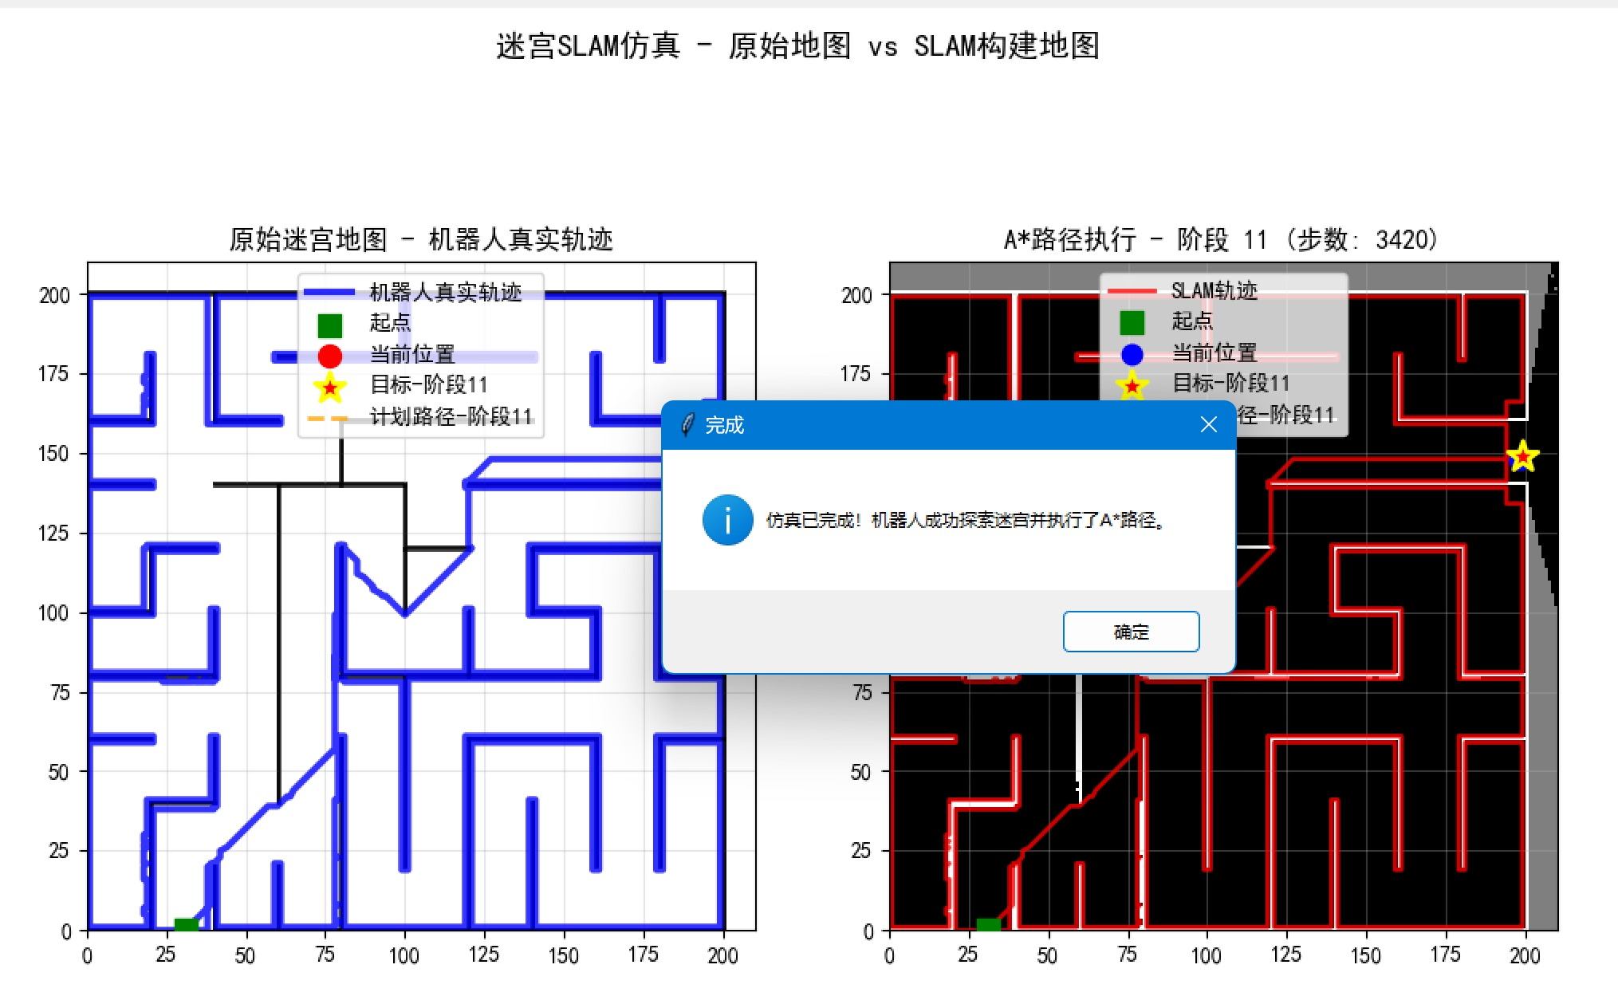
3. Key Features: Software Path Planning and Return Navigation
🧭 When maze exploration completes, the robot knows the full environment layout.
🗺️ The explored map is gridized, making it suitable for classic graph search algorithms.
⭐ A* Algorithm is applied to compute the shortest path from current position back to the start point.
⛓️ The algorithm considers:
Grid obstacles
Movement costs
Heuristic distance
✅ The result is a safe, efficient return trajectory.
🚙 The robot then follows this path to complete a full exploration-return loop.
Figure8: Shortest Path Planning using A*

